Slide 1



ZEROWASTE
TEAM BRAINROT

Slide 2
MOTIVATION
Our application ZeroWaste was created to aid users in avoiding distractions on mobile phones as they worked on their daily tasks.

Slide 3
TOP REQUIRMENTS
● Is easy for the users to understand and utilize.
● Provides a clean interface to lessen user error.
● Locks apps by blocking their notifications and usage.
● Can cancel app locking early based on user input.
● Notifies the user when the timer is completed.
● Can work on multiple mobile devices.

Slide 4

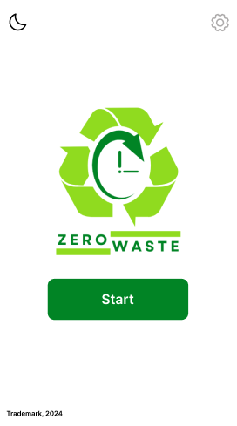

SOLUTION DESIGN:
ZEROWASTE

Slide 5
SOLUTION DESCRIPTION
ZeroWaste, aids users in avoiding distractions as you work on your job or tasks. It is an application that allows you to choose when distractions, such as social media, messaging with friends, or entertainment, become limited with a push of a button.

Slide 6
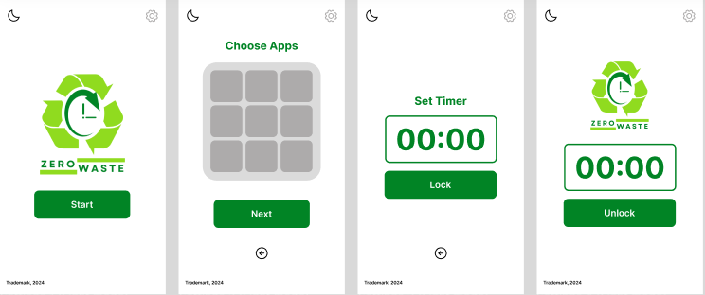
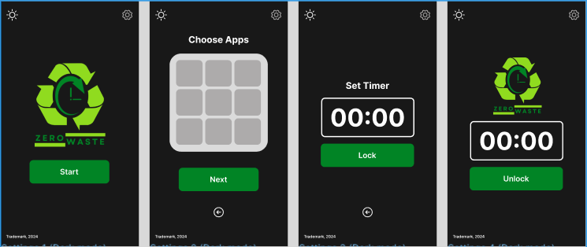
APPLICATION PROTOTYPE
LIGHT MODE
DARK MODE

Slide 7
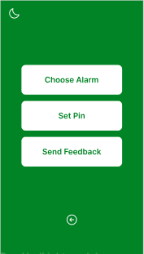
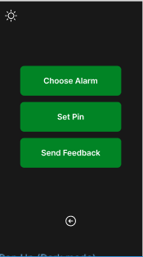
APPLICATION PROTOTYPE

Slide 8
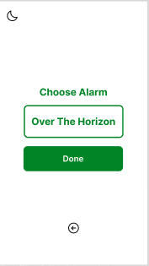
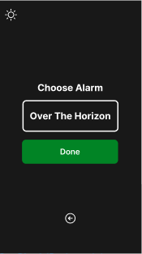
APPLICATION PROTOTYPE

Slide 9
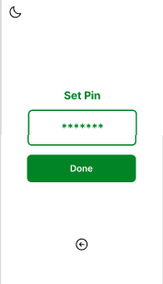
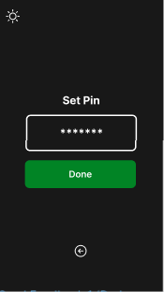
APPLICATION PROTOTYPE

Slide 10
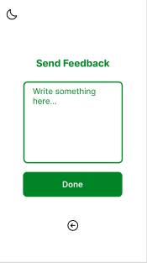
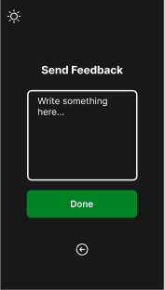
APPLICATION PROTOTYPE

Slide 11

EVALUATION PLAN
Usability Specifications
Usability Specifications is the technique used to evaluate the level of usability that the Prototype has. It consists of tasks that will be done by Participants. Furthermore, the Technique will contain timing the speed of the participants at a given task. The tasks will be split into 3 Sections: Start Menu, App Selection Task, Timer Setting Task. These task are chosen to properly identify what flaws are seen when the user interacts with the prototype and how easy it is to use said prototype.

Slide 12
EVALUATION PLAN
Heuristics Evaluation
Heuristics Evaluation will assess the UX design of the ZeroWaste prototype against industry-standard usability principles. This technique is chosen to provide a quick and accessible way to evaluate the validity of the prototype's design, particularly when time or resources are limited.

Slide 13
EVALUATION PLAN
Participant Survey and Feedback
After interacting with the prototype, participants will be given a survey. The survey will contain quantitative questions interpreted on a 5-point Likert Scale and qualitative questions in the form of open-ended feedback. This approach ensures that no designer bias influences the results of this evaluation.

Slide 14
PROTOTYPE TESTING
A selected participant will try out the prototype
A total of 3 questions will be asked:
) On a scale from 1-5 how would you rate your experience with ZeroWaste?
) On a scale from 1-5 how would you rate the UI design of ZeroWaste?
) How easy was it to follow the provided tasks/navigate ZeroWaste

Slide 15
OBSERVATIONS
From the what we observed the the user find the application functioning and user experience was great overall
The user also enjoyed the UI design for the application and had no complaints expected for the settings part
The user was able to navigate and use all the function of the application

Slide 16
CONCLUSION
With more time, we could have conducted in-depth user research and usability testing to gather comprehensive feedback from a diverse range of users. This would have enabled us to identify and address potential issues more effectively, refine our design to better meet user needs, and ensure a more intuitive and user-friendly interface. Additionally, we could have explored advanced features and integrations, optimized performance, and conducted thorough quality assurance to enhance the overall user experience.
Everest Cantu
Drew Holloway
Remy Marsh

Slide 17

THANK YOU FOR LISTENING!

